Slide 1

The Effects of Culture on Management

Slide 2
Notice
This presentation was based on the lecture of Zlatan Nedelko in the topic of culture and management.
All videos are used only for presentation and their copyright are respected, with credits and links to authors.

Slide 3
Hungary
ALX Greece
Hungary A Piece of the East in the West
https://www.youtube.com/watch?v=p1CEvILZUzo

Slide 4
Óbuda University
Óbudai Egyetem
Óbuda University: Talent. Success. Community
https://www.youtube.com/watch?v=ibKdwR_kWvI

Slide 5
#numbers
Number of students: 13.000
Number of teaching staff (full-time equivalent): 346
Number of administrative staff: 381
source: https://uni-obuda.hu

Slide 6


Faculty/Centre System
Bánki Donát Faculty Mechanical and Safety Engineering
Kandó Kálmán Faculty Electrical Engineering
Keleti Károly Faculty of Business Administration and Management
John von Neumann Faculty Informatics
Rejtő Sándor Faculty of Light Industry and Environmental Engineering
Alba Regia Technical Faculty in Székesfehérvár
Trefort Ágoston Centre for Engineering Education
Salgótarján Centre for Education and Research
Kisvárda Centre for Education and Research
source: https://uni-obuda.hu

Slide 7
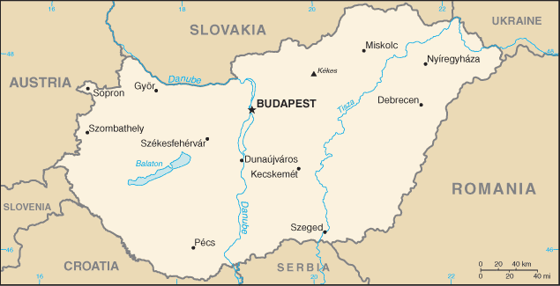
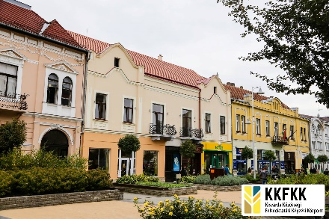
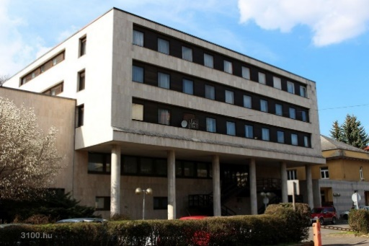

Locations
Kisvárda
Salgótarján
Székesfehérvár

Slide 8
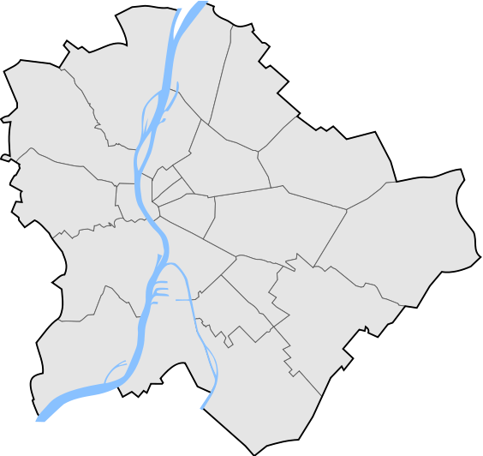
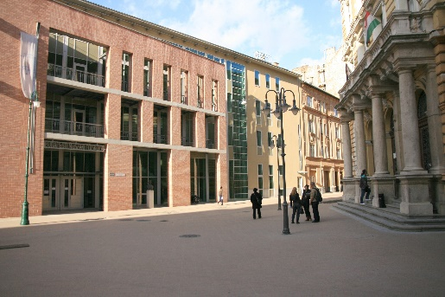
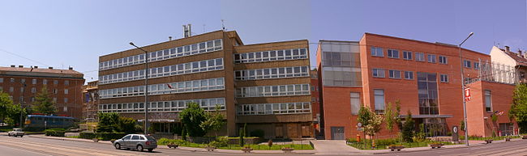
Locations
Józsefváros
Budapest
Óbuda campus

Slide 9
Language of teaching
Mainly Hungarian, but English and German courses and programs are also available.

Slide 10
Accredited BSc/BA programs
Land Surveying and Land Management Engineering
Mechanical Engineering
Engineering management
Electrical engineering
Computer Science Engineering
Mechatronic Engineering
Safety Engineering
Commerce and Marketing
Business Administration and Management
Technical Management
Industrial Design Engineering
Environmental Protection Engineering
Light Industry Engineering
source: https://uni-obuda.hu

Slide 11
MSc Programs
Business Development
Applied Mathematics
Safety Engineering
Mechatronic Engineering
Mechanical Engineering
Electrical Engineering
Computer Science Engineering
Light Industry Engineering
source: https://uni-obuda.hu

Slide 12
PhD schools
Doctoral School of Applied Informatics and Applied Mathematics
Doctoral School on Materials Sciences and Technologies
Doctoral School on Safety and Security Sciences
source: https://uni-obuda.hu

Slide 13
Programs in English
Environmental Engineering BSc
Industrial Design Engineering BSc
Computer Engineering BSc and MSc
Electrical Engineering BSc
Technical Manager BSc
Mechatronics Engineering BSc and MSc
Mechanical Engineering
Business Development MSc (from 2018)
source: https://uni-obuda.hu

Slide 14
PhD programs in English
Doctoral School of Applied Informatics and Applied Mathematics
Doctoral School on Materials Sciences and Technologies
Doctoral School on Safety and Security Sciences
source: https://uni-obuda.hu

Slide 15
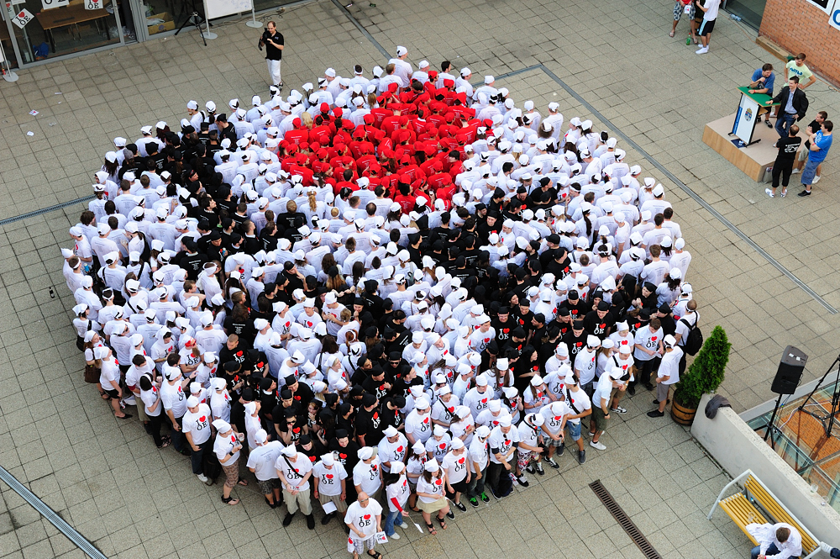
http://erasmus.uni-obuda.hu
source: https://uni-obuda.hu

Slide 16
The Effects of Culture on Management
source: https://pexels.com

Slide 17
Content of the lecture
Definition of culture
Organizational culture - the role and importance of culture in business
Business culture and its understanding
Typical characteristics of business culture – case of Germany, USA, China, Russia, Japan and the Gulf area; example of typical business culture in Slovenia; South Korea; Africa
Discussion – identifying typical business culture in selected economy; differences and similarities in business cultures across the globe

Slide 18
I. What is culture
Culture - The arts and other manifestations of human intellectual achievement regarded collectively
(Oxford dictionary)
Culture consists of patterns, explicit and implicit, of and for behavior acquired and transmitted by symbols, constituting the distinctive achievements of human groups, including their embodiments in artifacts (Kroeber and Kluckhohn, 1952, p. 86)
Culture is the collective programming of the mind
that distinguishes the members of one organization from others (Hofstede, 2001)
Prevailing set of values accepted by society/group
(Potocan et al. 2007)
Culture is the set of key values, belies, understandings, and norms that members of an society share (Daft, 2000)

Slide 19
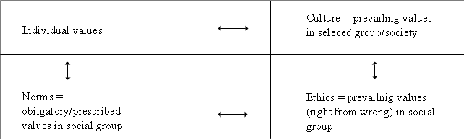
I. Culture and values
Culture in the broader context

Slide 20
Determinants of culture
Economic philosophies
Political philosophies
Education
Language
Religion
Societal structure

Slide 21
I. Culture in different contexts
Culture (regarding the model of its consideration) can be applied on different levels/areas
Individual culture
Group culture
Regional culture
National culture
Organizational/corporate culture
Business culture

Slide 22
II. Schein’s three levels of culture

Slide 23
III. Business culture
Business culture is a “model or style of business operations within a company. The business culture determines how different levels of staff communicate with one another as well as how employees deal with clients and customers”
What encompasses business culture?
How is business culture different from organizational culture
Differences between national, organizational, and business culture

Slide 24
III. Scope of business culture
Business culture thus encompass “the culture of all (important/influental) business subjects and individuals in a country”

Slide 25
III. Understanding business culture
Some basic criterions for understanding business culture
Communication style
Working style
Discussion style
Business attitude
Leadership style
Business relationship
Decision-making style
Basis for decision-making
Attitude to time
Work-life balance

Slide 26
III. A framework for comparison business cultures

Slide 27
In detail
Communication style
Direct | Indirect
Gets to the point | Encircles the point
Criticizes | Saves face
Faces disagreements | Avoids disagreements
Addresses issues directly | Addresses issues sideways-on
Working style
Formal | Informal
Prefers business dress | Prefers “dress-down”
Uses surnames and titles | Uses first names
Closed door | Open door
Prefers a more formal style of speech | Prefers a more familiar and intimate style of speech

Slide 28
In detail
Discussion style
Fast moving | Slow and measured
Interrupts more | Never interrupts
Talks more and quickly | Prefers measured tone and pace
Converstaion has to keep moving | Pauses are acceptable
Dislikes silence | Is tolerant of silence
Business attitude
Progressive | Traditional
Embraces change | Needs change to be based in present practice
Likes new technology | Is cautious in adopting new technology
Seeks new organizational methods | Prefers “tried and tested” solutions
Wants new people | Prefers loyal staff

Slide 29
In detail
Discussion style
Fast moving | Slow and measured
Interrupts more | Never interrupts
Talks more and quickly | Prefers measured tone and pace
Converstaion has to keep moving | Pauses are acceptable
Dislikes silence | Is tolerant of silence
Leadership style
Flat | Vertical
Communicates directly | Communicates through hierachy
Community decision | Leader decision (often after consultation)
Two-way feedback | Top-down feedback
Strict line management reporting | Dotted line matrix reporting
Business attitude
Progressive | Traditional
Embraces change | Needs change to be based in present practice
Likes new technology | Is cautious in adopting new technology
Seeks new organizational methods | Prefers “tried and tested” solutions
Wants new people | Prefers loyal staff
Business relationship
Relationship | Task
Takes time building relationship | Focuses on getting the job done
Won’t work with you unless he/she likes and trusts you | May begin wiht small-scale deals and then build up
Takes an interest in understanding the people | Focuses on tasks rather than people
My business colleauge is my friend | Business and friendship don’t mix

Slide 30
In detail
Decision-making style
Individualistic | Collective
Risk taking | Risk averse
Decides first then persuades others | Seeks consensus, then decides
Makes own decisions within budget and job description | Decisions and budgets are agreed with management
Is accountable for decision and implementation | Takes decisions agreed by higher management and is accountable for implementation
Communication style
Direct | Indirect
Gets to the point | Encircles the point
Criticizes | Saves face
Faces disagreements | Avoids disagreements
Addresses issues directly | Addresses issues sideways-on
Basis for decision making
Facts | Instincts
Makes decisions on basis of data and figures | Makes decisions on instinct and intuition
Personal connections are not important in decision-making | Personal connections are an important factor
Maintains a strict criteria-based system | Prefers to work with existing contacts
Agreements are independent of hospitality of gift-giving | Agreement are usually accompanied by hospitality and gift giving

Slide 31
In detail
Discussion style
Fast moving | Slow and measured
Interrupts more | Never interrupts
Talks more and quickly | Prefers measured tone and pace
Converstaion has to keep moving | Pauses are acceptable
Dislikes silence | Is tolerant of silence
Attitude to time
Scheduled | Flexible
Time conscious | Relaxed about time
Punctual | Late
Schedules by the clock | Schedules by activity
Meetings start and end on time | Completing the business is more important than schedule
Work/life balance
Live to work | Work to live
Overtime expected | Overtime unusual
Taking work home admired | Taking work home criticized
Out of hours phone contact tolerated | Out of hours phone contact unacceptable
Weeked working normal | Weekend working exceptional
Business attitude
Progressive | Traditional
Embraces change | Needs change to be based in present practice
Likes new technology | Is cautious in adopting new technology
Seeks new organizational methods | Prefers “tried and tested” solutions
Wants new people | Prefers loyal staff

Slide 32
IV. World’s business cultures
Typical characteristics of business culture
Germany
USA
China
Russia
Japan
the Gulf area

Slide 33
Germany

Slide 34
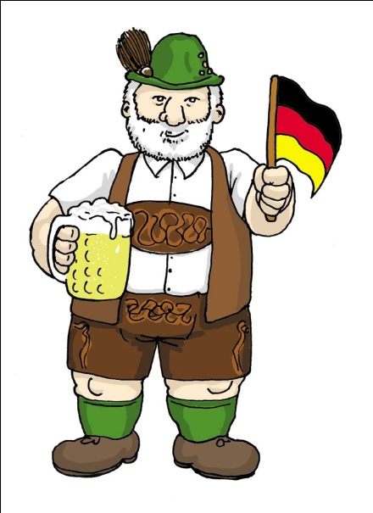
Germany
Salford Business School
Did you know? - Germany - German Business Culture video
https://www.youtube.com/watch?v=g32EUWeaAvA

Slide 35
Germany
Eumirbanshee
Business Etiquette Protocol of Germany
https://www.youtube.com/watch?v=g32EUWeaAvA

Slide 36
USA

Slide 37
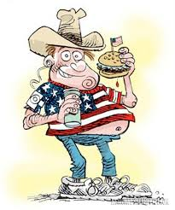
USA
The USA business culture
Kwintessentialvids
The USA Culture. American Cultural Differences in Business and Etiquette
https://www.youtube.com/watch?v=NuHLDFDrh1E

Slide 38
China

Slide 39
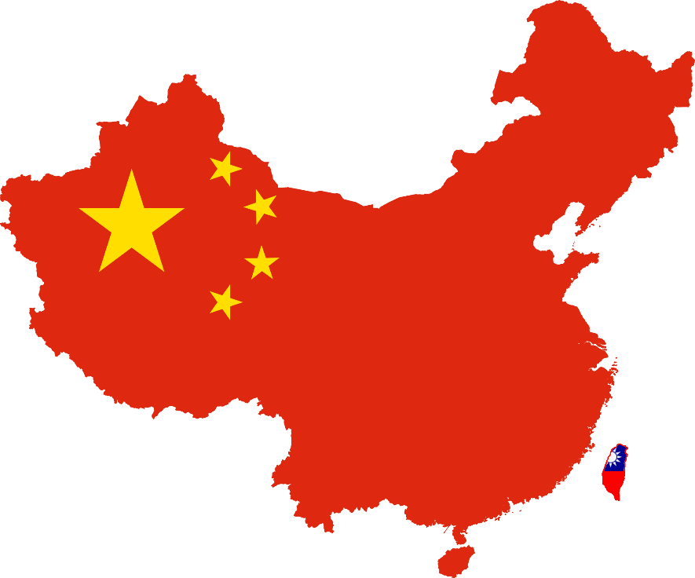
China
One-quarter of the world‘s population
(1.5 billion people)
Rapid economic growth
Increasing openness
Growing consumer market
Expanding business opportunities

Slide 40
Cultural Differences
Consensus
Confucian system – ethics and morals
Decision-making
„Manzi“ – face 面子
„Guanxi“ – connections 关系
The role of the world „NO“

Slide 41
Phrasing for success
American | Chinese
Do you understand? | Are we clear?
What? | Could you please repeat that as we did not understand?
We cannot do that. | That maybe difficult for us to do.
What is the problem? You said you Fedex’d us the papers but we did not get them. | There must be a problem with the courier because we did not receive the papers.

Slide 42
The Chinese Negotiation
(John L. Graham and N. Mark Lam)
American | Chinese
Individual | Collective
Egalitarian | Hierarchical
Information oriented | Relationship oriented
Reductionism/Linear | Holistic / Circular
Argument culture | Haggling culture

Slide 43
The Chinese Negotiation
(John L. Graham and N. Mark Lam)
American | Chinese
Time is money – fast meetings | A getting to know process
Informal | Formal
Cold calls | Intermediaries
Full authority | Limited authority
Proposes desired solutions first | Explaines desired goals first
Aggressive | Questioning
Impatient – make a good deal | Enduring – seeks a relationship

Slide 44


Chinese Proverb...
The chicken said to the pig:
    „Let‘s make breakfast. I‘ll supply the eggs,
    and you supply the bacon!“

Slide 45
Tips for success
Build guanxi - Find the right people
Think beyond the short term
Be sensitive to timing
Turn negatives into positives
Show it is good for China
Be flexible
Avoid becoming indebted
Build on successes and failures
Minimize your "no's"
Control your emotions
Increase your importance (status)
But, be yourself - You are not Chinese!

Slide 46

Doing business in China
nettresults
20 Tips on Chinese Culture for Successful Business
https://www.youtube.com/watch?v=H6g7tUcoF3I

Slide 47
Russia

Slide 48

Doing business in Russia
Russia Direct
8 tips on how to deal with Russian business partners
https://www.youtube.com/watch?v=SB-30eKjG2A

Slide 49
Japan

Slide 50
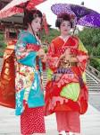
Japan
docstocTV
How to do Business in Japan
https://www.youtube.com/watch?v=aLwnLZdznVA
docstocTV
Conducting Yourself in a Japanese Business Meeting
https://www.youtube.com/watch?v=j2nU9KoB8hM

Slide 51
The Gulf

Slide 52
The Gulf Area/Middle East
nettresults
10 Tips on Arab Culture for Successful Business in the Middle East
https://www.youtube.com/watch?v=U9XoD9V9Bvg

Slide 53
South Korea
Dương Trịnh Ngọc Ánh
South Korea Business Etiquettes
https://www.youtube.com/watch?v=_6_2J0pQ7cE

Slide 54
South Korea

Slide 55
All considered
countries

Slide 56
V. Discussion
According to the proposed framework for considering world business cultures – how can “Serbian business culture can be positioned”
How does a presence of multinational companies shapes business culture in Serbia?
What will you suggest (i.e. tips and tricks) as “a consultant” for doing business in Serbia?

Slide 57
Category | Nummber (1-10)
1.
2.
3.
4.
5.
6.
7.
8.
9.
10.
Placement of Serbian business culture
according to students of the lecture

Slide 58
http://erasmus.uni-obuda.hu
source: https://uni-obuda.hu

